Slide 1
Calendar Year End
Laura Hofstrand – Diocese of Des Moines

Slide 2
Affordable Care Act (ACA) Reporting
For those that are small employers (less than 50 full-time equivalent employees)
The Diocese has contracted with ACA Prime to file our forms for us.
Therefore each parish that is a small employer will not need to do anything for ACA reporting this year.
This will not cost the parish anything as the Diocese will be paying for this service.
For those that are large employers (greater than 50 full-time equivalent employees)
You will still need to file those yourself as you have in prior years.
For those that outsource your payroll, your payroll vendor should be able to assist with this.

Slide 3
W-2’s
Include any cash gifts, gift cards or certificates to employees on the W-2 as compensation. Non-cash small gifts don’t have to be included. Larger non-cash gifts would also be included in compensation.
W-3 totals should match all four 2023 941’s filed
Recommendation:
In January/February we suggest sending an email to all employees asking if there are any updates they would like to make to their W-4’s (martial status changes, children etc.) This would affect tax year 2024.

Slide 4
W-2’s
All Employees paid in 2023 thru payroll receive a W-2
ParishSOFT Payroll – Can print the forms or e-file
State of Iowa requires either e-filing or for the information to be entered manually on their website (GovConnectIowa). https://govconnect.iowa.gov/tap/_/ Questions, go to: https://tax.iowa.gov/electronic-filing-w-2-wage-statements-and-1099-information-returns
ParishSOFT Payroll e-filing: see https://support.parishsoft.com/hc/en-us/articles/115002019547
Due January 31st to Government and Employees

Slide 5
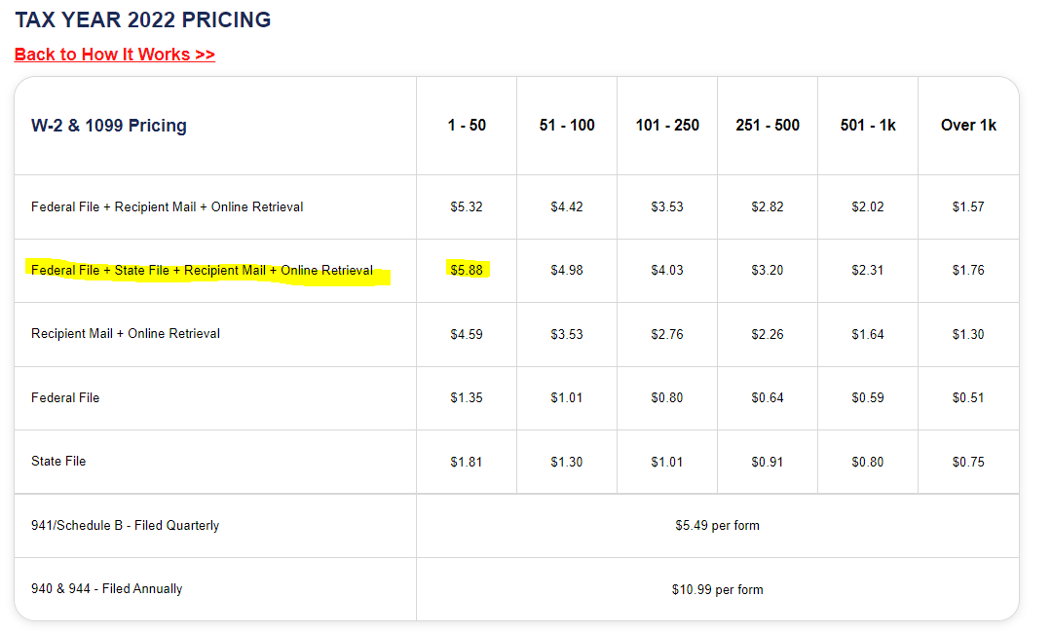
ParishSOFT Payroll E-Filing 2022 Pricing for W-2’s with Nelco
Note: the prices above are per form and from 2022

Slide 6
1099 NEC
Someone you paid at least $600 in the calendar year for services performed by a non-employee that is not incorporated.
This includes payments to attorney’s, even if the attorney is incorporated.
Use Vendor Audit Report in ParishSOFT Accounting to verify that all 1099 vendors are marked as such.
If you don’t have a W-9 for the vendor, you should obtain one. It is a good idea to request one when you have a new vendor.
Refer to Resource Manual: Section 302.2 Form 1099 Information returns.
Due January 31st to IRS and vendor.

Slide 7
1099-MISC
A Parish/School would normally not have many 1099-MISC’s, but an example of one would be if you paid rent $600 or more in the year to a non-incorporated vendor.
Due January 31st to IRS and Vendor.
For help with 1099’s see: https://www.irs.gov/pub/irs-pdf/i1099mec.pdf

Slide 8
E-Filing 1099’s in Psoft Accounting
Both 1099-MISC and 1099-NEC forms can be e-filed.
Under Reports>Vendors you will see an option to e-file the 1099-MISC and the 1099-NEC
This will work similarly to the e-filing of W-2’s thru ParishSOFT Payroll.
Forms are uploaded to Nelco (Greatland) who actually files the forms.
Refer back to the W-2 pricing slide for pricing on 1099’s (price is the same for e-filing 1099’s as W-2’s.)

Slide 9
Contribution Statements
IRS requires for any 1 donation that is given at $250 or more during the year.
Any 1 donation that is $250 or more must be itemized on the statement.
We recommend you send the statement to all who gave in 2023.
Detail/(Itemized) version out of ParishSOFT Offering is recommended – i.e. lists the dates and amounts of each transaction
The Contribution Statement should have the following language and you can add this in ParishSOFT Offering before printing the statements
”(Name of Organization) did not provide you with any goods or services in whole or in part for this contribution other than intangible religious benefits.”
Resource Manual: Section 203.14 End of Year Contribution Statements.
Due January 31st to donors.

Slide 10
Priest Housing Letter
Required letter to your Priest for upcoming year regarding housing.
Letter should say fair market value (FMV) of housing provided:
Rectory: What would it cost to rent something similar in your area for the year.
Actual rent paid
Resource Manual: Section 403.3 Priest Housing.
There is also a sample priest housing letter in the Resource Manual appendix
Signed by FC Chair and issued for 2023 before January 1, 2024.

Slide 11
Sales and Use Tax
Sales tax is due on any Iowa invoices that sales tax was not included but should have been. Sales tax is also due on raffle and bingo gross sales
Use tax is due on products purchased from outside of Iowa with no Iowa sales tax charged.

Slide 12
Sales and Use Tax
As July 1, 2022 the sales and use taxes were combined on one tax form. The filing requirements changed also.
If the tax liability is less than $1,200 per year, an annual return is required.
If the $1,200 amount is reached during the year, the filing requirement is then monthly for the remainder of the year.
The filings (annual & monthly) should be e-filed thru GovConnectIowa
Annual return is due January 31st.
Monthly returns are due the last day of the following month
For questions or help go to: https://tax.iowa.gov/sales-and-use-tax-permit-return-filing-and-payment-changes

Slide 13
Iowa Annual Gambling Report
Raffles and Bingo both require gambling and sales tax permits
For help go to: https://tax.iowa.gov/iowa-tax-gambling
You may contact the State by calling 515-281-6848 or emailing scg@dia.iowa.gov.
Annual Gambling Report for calendar 2023 due January 31, 2024.
Will receive a letter from State in early January if had a license at any point during the year. Letter will include instructions on where and how to complete annual report.
Resource Manual Section 204.1 Fundraising Activities

Slide 14
Questions?

