Slide 1

IT Discussion Items

Slide 2
St. Boniface Malware Attack< April 4, 2024
George McNulty: Business Manager

Slide 3
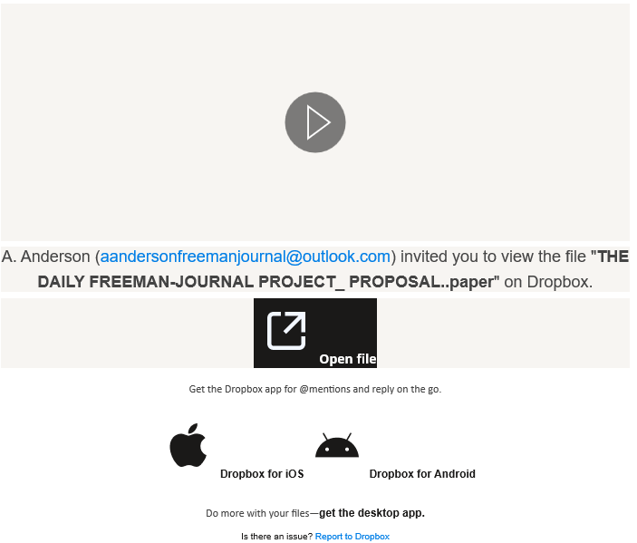
Dropbox Scams
Seeing more Dropbox, Onedrive etc. file share scam emails
Reach out to sender
in a separate email
or phone call

Slide 4

CMG Connect
Training opportunities
https://desmoines.cmgconnect.org/accounts

Slide 5
Website Update
Efforts to make our website easier to navigate
https://www.dmdiocese.org/resources/technology

Slide 6
Parishsoft MFA
This will be rolled out in the near future to all
Parishsoft Accounting users
ParishSOFT Accounting – Multi-Factor Authentication - ParishSOFT

Slide 7

Thank You!

